Slide 1
Title-2 Issues in Engineering Ethics

Slide 2
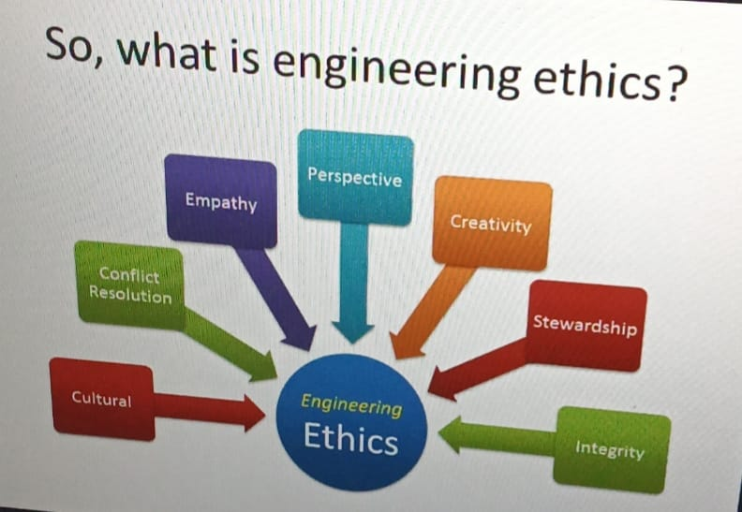
What is Engineering Ethics?
Engineering ethics is the study of moral and ethical issues in engineering practice.
It ensures engineers act responsibly toward society, environment, and profession.
Helps prevent harm and promotes safety, fairness, and sustainability.

Slide 3
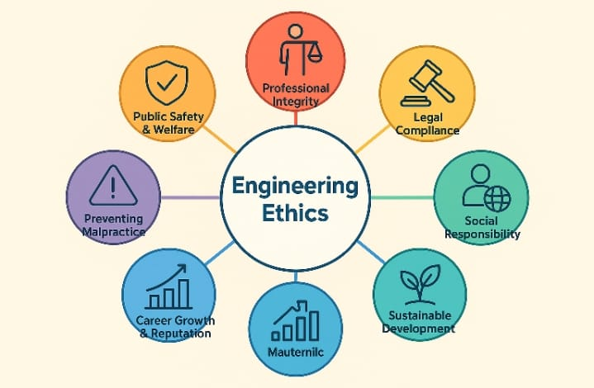
IMPORTANCE OF ENGINEERING ETHCS
Why Ethics Matter in Engineering Content ?
Ensures public safety and welfare
Promotes professional integrity
Prevents legal issues and professional misconduct
Encourages accountability and sustainability

Slide 4
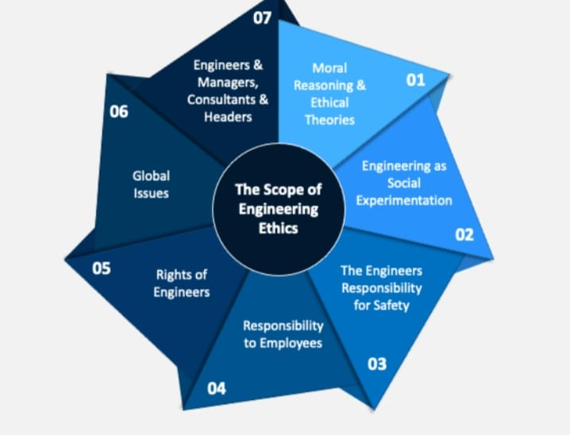
COMMON ETHICAL ISSUE IN ENGINEERING ETHICS
Key Issues in Engineering Ethics
Violations: Ignoring safety Safetystandards or shortcuts
Conflict of Interest: Personal gain over professional duty
Environmental Negligence: Lack of sustainable practices
Data Falsification: Misrepresentation of results or reports
Intellectual Property Misuse: Plagiarism or patent violations

Slide 5
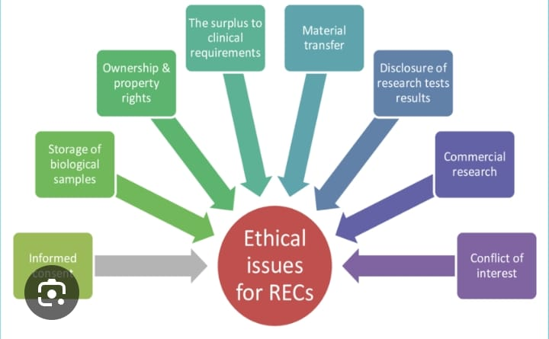
CAUSES OF ETHICAL ISSUES
Title: Why Ethical Issues Arise
Pressure to meet deadlines or budgets
Lack of ethical awareness or training
Corruption or personal gain
Ambiguous policies and weak regulations

Slide 6
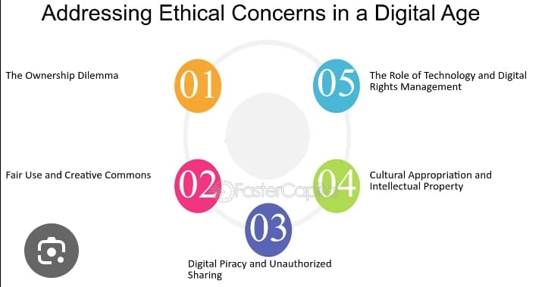
HOW TO ADDRESS ETHICAL ISSUES?
Title: Solutions & Best Practices
Education and training on professional ethics
Strong adherence to codes of conduct
Transparency and accountability in decision-making
Regular audits and compliance checks
Encouraging reporting of unethical practices

Slide 7

C0NCLUSI0N
Ethical issues are inevitable but manageable through awareness, rules, and personal integrity
.Responsible engineering ensures safety, trust, and sustainable development
.Strong ethics build credibility and professional growth.

Slide 8
Thank you

